Slide 1
AI scheduler models for the samrt calendar app
By chaari mahmoud

Slide 2
Introduction to Presentation
Problem Statement:
Scheduling and managing time efficiently is a common challenge, especially in today's busy world. Coordinating schedules across teams and individuals adds another layer of complexity. What if there was a way to streamline this process using AI and natural language interactions, making time management effortless and intuitive?

Slide 3
Introduction to Presentation
Solution Overview:
We propose the development of an innovative calendar application using Flutter, integrating AI models for automatic event scheduling based on user routines and priorities. Additionally, we aim to implement a feature where users can capture calendar-related information through photos, automatically populating events in the app.

Slide 4
GitHub Repository 1: Atomic Calendar
Repository Overview:
Atomic Calendar leverages vector-based search and Autopilot AI features for seamless time management. It offers functionalities like semantic search, automated tagging, flexible meetings, time preferences, event training, time blocking, priority settings, and more.
https://github.com/rush86999/atomic

Slide 5
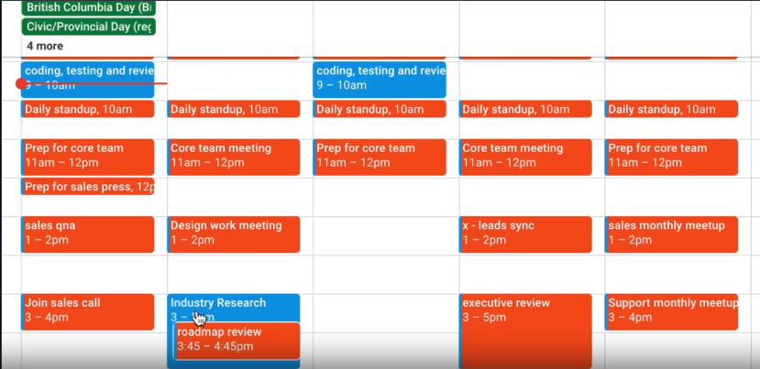
GitHub Repository 1: Atomic Calendar

Slide 6
GitHub Repository 1: Atomic Calendar
Key Features:
Semantic search for event templates
Automated tagging using AI classification
Flexible meeting scheduling
Autopilot AI planner for event management
Time preferences and priority settings

Slide 7
GitHub Repository 2: Smart Calendar
Repository Overview:
Smart Calendar is an AI-powered calendar app designed for simplicity. It enables users to effortlessly add events, meetings, and tasks by capturing photos or screenshots of relevant text, offering a new level of convenience.
https://github.com/SmartCalendar/SmartCalendar

Slide 8
GitHub Repository 2: Smart Calendar

Slide 9
GitHub Repository 2: Smart Calendar
Key Features:
Image-based event creation using camera input
Seamless syncing with Google Calendar
Traditional calendar functionalities with AI enhancements
App Evaluation:
Targeting productivity and lifestyle segments, Smart Calendar caters to users of all ages, especially those reliant on digital calendars for organizing daily activities.

Slide 10
App Development Plan
Required Features:
User Authentication:
User can create an account or login with existing credentials.
Calendar Views:
Daily view: User can see events for the selected day.
Monthly view: User can see a broader overview of events for the month.
Event Management:
User can manually create, modify, and delete events on their calendar.
Camera Integration:
User can use their phone camera to capture text (events, tasks) and auto-fill calendar event details.

Slide 11
App Development Plan
Optional Features:
Color Coding:
User can assign colors to events for visual organization.
Priority Setting:
User can set priority levels for events to indicate importance.
Invite Others:
User can invite others to events or meetings directly from the app.
Account Management:
User can link multiple accounts (e.g., Google, Apple) for syncing events.
Offline Access:
User can access their calendar and make changes even without an internet connection.

Slide 12
Screen Archetypes
Login Screen:
User can log in or create a new account.
Calendar Views:
Monthly View Screen: Displays a monthly calendar grid.
Daily View Screen: Shows events for the selected day with options to navigate to other days.
Event Details Screen:
Shows detailed information about a specific event and allows editing/deletion.
Event Creation Screen:
Form to input event details manually or using the camera for text recognition.

Slide 13
Conclusion
Recap of Key Points
Atomic Calendar:
Leveraging vector-based search and Autopilot AI for efficient time management.
Features include semantic search, automated tagging, flexible meetings, and time preferences.
Smart Calendar:
AI-powered calendar app focused on simplicity and convenience.
Unique feature: Image-based event creation using camera input.
Seamless syncing with Google Calendar for cross-device accessibility.

